Slide 1
Parsing I
Adeesha Wijayasiri

Slide 2
Topics
Context-free Grammars
Derivation Trees
Transduction Grammars
Ambiguity
Grammar Reduction.
The Game of Syntactic Dominoes
Strategies for parsing
Top-Down Parsing
Define OPF

Slide 3
Context-free grammars
Definition: A context-free grammar (CFG)
is a quadruple G = (Φ, Σ, P, S), where all productions are of the form A → α, for A ∊ Φ and α ∊ (Σ∪Φ )*.
Re-writing using grammar rules:
βAγ ⇒ βαγ if A → α (derivation).
Left-most derivation: At each step, the left-most nonterminal is re-written.
Right-most derivation: At each step, the right-most nonterminal is re-written.

Slide 4
Sample grammar and derivations

Slide 5
Derivation trees
Describe re-writes, independently of the order (left-most or right-most).
Each tree branch matches a production rule in the grammar.
Leaves are terminals.
Bottom contour is the sentence.
Left recursion causes left branching.
Right recursion causes right branching.

Slide 6
Transduction Grammars
Definition: A transduction grammar (a.k.a. syntax-directed translation scheme) is like a CFG, except for the following generalization:
Each production is a triple (A, β, ω) ∈ Ф x V* x V*, called a translation rule, denoted A → β => ω, where
A is the left part,
β is the right part, and
ω is the translation part.

Slide 7
Transduction Grammars
Derivation:
( E , E )
=> ( E + T, E T + )
=> ( T + T, T T + )
=> ( P + T, P T + )
=> ( i + T, i T + )
=> ( i + P * T, i P T * + )
=> ( i + i * T, i i T * + )
=> ( i + i * i, i i i * + )
Translation of infix to postfix expressions.
E → E + T => E T +
→ T => T
T → P * T => P T *
→ P => P
P → (E) => E
→ i => I
The translation part describes how the output is generated, as the input is derived.

Slide 8
Transduction Grammars
Transduction to Abstract Syntax Trees
Notation: < N t₁ … t_{n} > denotes
String-to-tree transduction grammar:
E → E + T => < + E T >
→ T => T
T → P * T => < * P T >
→ P => P
P → (E) => E
→ i => i
N
t₁ … t_{n}
Derivation:
(E , E)
=> (E+T, <+E T>)
=> (T+T, <+T T>)
=> (P+T, <+P T>)
=> (i+T, <+i T>)
=> (i+P*T, <+i<*P T>>)
=> (i+i*T, <+i<*i T>>)
=> (i+i*P, <+i<*i P>>)
=> (i+i*i, <+i<*i i>>)
+
i
*
i
i

Slide 9
Transduction Grammars
Definition: A transduction grammar is simple if for every rule A → α => β, the sequence of nonterminals in α is identical to the sequence in β.
E → E + T => < + E T >
→ T => T
T → P * T => < * P T >
→ P => P
P → (E) => E
→ i => I

Slide 10
Grammar ambiguity
Goal of parsing:
Examine input string, determine whether it's legal.
Same as: try to build derivation tree.
Therefore, tree should be unique.
Definition: A CFG is ambiguous if there exist two different right-most (or left-most) derivations for some sentence z.
(Equivalent) Definition: A CFG is ambiguous if there exist two different derivation trees for some sentence z.

Slide 11
Classic ambiguities
Simultaneous left/right recursion:
E → E + E
→ i
Dangling else problem:
S → if E then S
→ if E then S else S
→ …
Ambiguity is undecidable:
no algorithm exists.

Slide 12
Grammar reduction
What language does this grammar generate?
S → a D → EDBC
A → BCDEF E → CBA
B → ASDFA F → S
C → DDCF
L(G) = {a}
Problem: Many nonterminals (and productions) cannot be used in the generation of any sentence.

Slide 13
Grammar reduction
Definition: A CFG is reduced iff for all A ∈ Ф,
a) S =>* αAβ, for some α, β ∈ V*, (we say A is generable),
b) A =>* z, for some z ∈ Σ* (we say A is terminable).
G is reduced iff every nonterminal A is both generable and terminable.
Example: S → BB A → aA
B → bB → a
B is not terminable, since B =>* z, for any z ∈ Σ*.
A is not generable, since S =>* αAβ, for any α,β∈V*.

Slide 14
Grammar reduction
To find out which nonterminals are generable:
Build the graph (Ф, δ), where (A, B) ∈ δ iff
A → αBβ is a production.
Check that all nodes are reachable from S.
Example: S → BB A → aA
B → bB → a
A is not reachable from S,
so A is not generable.
S
B
A

Slide 15
Grammar reduction
Algorithmically,
Generable := {S}
while(Generable changes) do
for each A → αBβ do
if A ∈ Generable then
Generable := Generable U {B}
od
{ Now, Generable contains the
nonterminals that are generable
}

Slide 16
Grammar reduction
To find out which nonterminals are terminable:
Algorithmically,
Terminable := { };
while (Terminable changes) do
for each A → X₁…X_{n} do
if every nonterminal among the X’s
is in Terminable then
Terminable := Terminable U {A}
od
{ Now, Terminable contains the nonterminals
that are terminable.
}

Slide 17
Grammar reduction
Reducing a grammar:
Find all terminable nonterminals.
Remove any production A→X₁…X_{n} if any X_{i} is not terminable.
Find all generable nonterminals.
Remove any production A → X₁ … X_{n} if A is not generable.

Slide 18
Grammar reduction
Example: E → E + T F → not F
→ T Q → P / Q
T → F * T P → (E)
→ P → i
Terminable: {P, T, E}, not Terminable: {F, Q}. So,
eliminate every production whose right-part contains either F or Q.
E → E + T T → P
→ T P → (E)
→ i
Generable: {E, T, P}, not Generable: { }. Grammar is reduced.

Slide 19
top-down parsing

Slide 20
The Game of Syntactic Dominoes
The grammar:
E → E+T T → P*T P → (E)
→ T → P → i
The playing pieces: An arbitrary supply of each piece
(one per grammar rule).
The game board:
Start domino at the top.
Bottom dominoes are the "input."

Slide 21
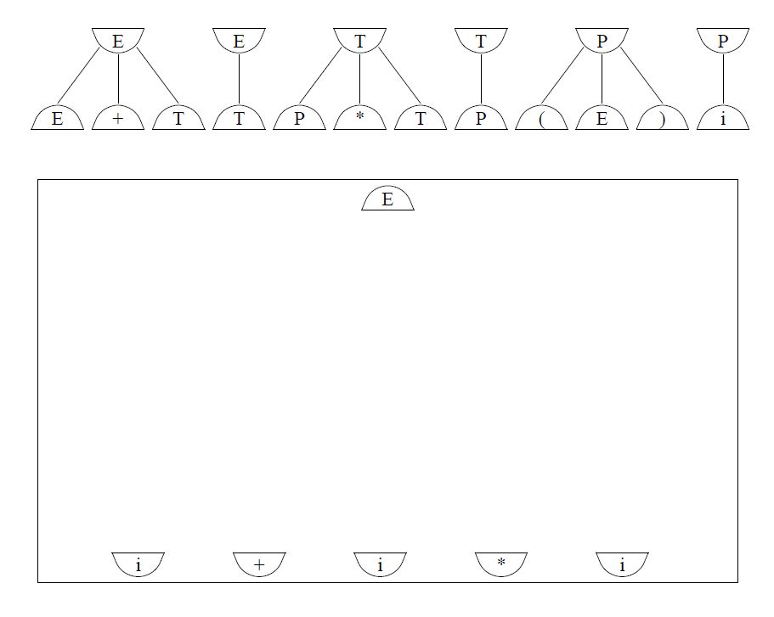
Syntactic dominoes: The Game Board

Slide 22
The Game of Syntactic Dominoes
Game rules:
Add game pieces to the board.
Match the flat parts and the symbols.
Lines are infinitely elastic (and cannot cross).
Object of the game:
Connect start domino with the input dominoes.
Leave no unmatched flat parts.

Slide 23
Parsing Strategies
Same as for the game of syntactic dominoes.
“Top-down” parsing: start at the start symbol, work toward the input string.
“Bottom-up” parsing: start at the input string, work towards the goal symbol.
In either strategy, can process the input left-to-right ☺ or right-to-left ☹

Slide 24
Top-Down Parsing
Attempt a left-most derivation, by predicting the re-write that will match the remaining input.
Use a string (a stack, really) from which the input can be derived.
Start with S on the stack.
At every step, two alternatives:
ω (the stack) begins with a terminal t: match t against input.
ω begins with a nonterminal A:
Consult an OPF (Omniscient Parsing Function) to determine
which production for A to use.

Slide 25
Sample top-down parse
E → E+T
→ T
T → P*T
→ P
P → (E)
→ i

Slide 26
Classic Top-Down Parsing Algorithm
Push (Stack, S);
while not Empty (Stack) do
if Top(Stack) ∊ ∑
then if Top(Stack) = Head(input)
then input := tail(input)
Pop(Stack)
else error (Stack, input)
else P:= OPF (Stack, input)
Push (Pop(Stack), RHS(P))
od

Slide 27
top-down parsing: general scheme

Slide 28
Top-Down Parsing
Most parsing methods (for PL’s) impose bounds:
input lookahead: 1.
We define OPF (A,t), where
A: top element of the stack, and
t: first symbol on the input.
Storage requirements: O(n²), where n is the size of the grammar vocabulary (a few hundred).

Slide 29
Sample OPF
Stack Input OPF
S → A
A → bAd
→
S bbdd⊥
OPF | d | b | ⊥
S |  | S → A | S → A
A | A → | A → bAd | A →

Slide 30
Acknowledgements
Programming Language Pragmatics by Michael L. Scott. 3rd edition. Morgan Kaufmann Publishers. (April 2009).
Lecture Slides of Dr.Malaka Walpola and Dr.Bermudez

